Slide 1
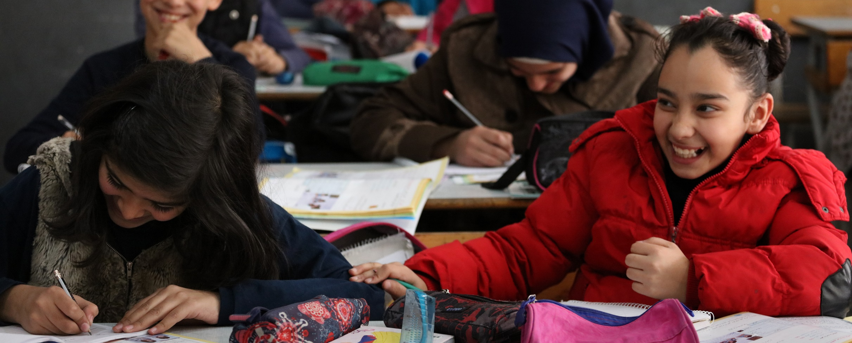
Comprehensive School-based & School-Linked Bullying Prevention:
An Evidence-Based Action Framework
FRESH WEBINAR
1 December 2020
Dominic Chavez-World Bank - Yemen
Mr. Yongfeng Liu, Programme Specialist, UNESCO
Prof. James O’Higgins Norman, Dublin City University, Ireland
Prof. Christian Berger, Pontificia Universidad Católica de Chile, Chile

Slide 2
UNESCO’s work around Safe and inclusive learning environments – key 2020 events
New international day against violence and bullying at school including cyberbullying – 5 November 2020
International Conference on School Bullying – 5 November 2020

Slide 3

The role of the Scientific Committee in identifying the recommendations on preventing and addressing school bullying and cyberbullying
Prior to the International Conference, a wide process of experts’ consultation to reflect on key recommendations to address bullying was initiated.
The process was led by a Scientific Committee comprised of French experts advising the French Ministry of Education, and international experts.
The result of this collaborative work is a set of key recommendations addressing three main elements:
1. A more inclusive definition of bullying
2. Effective approaches to respond to bullying
3. Responding to cyber-bullying more effectively

Slide 4
How to respond effectively to bullying and cyberbullying: The whole-education approach
At school level, comprehensive approach involving the whole school community
Whole-school approach
However schools exist within a wider education system and community. Need to recognize the interconnectedness of the school with the wider community including education, technological and societal systems
Whole-education approach

Slide 5
Revisiting the definition of school bullying: towards a more inclusive definition
Current definition
Clarifications through a revised definition
Importance of context: bullying and cyberbullying are relational phenomena that are enabled or inhibited by the social and institutional context of the education system.
Absence of responses and care: bullying implies an absence of care and responses by peers and adults.
Harm: Bullying and cyberbullying often cause emotional, social, and/or physical harm.
Repetition is relative: It also relates to the effect on the target who may fear that a once-off-event might be repeated.
Importance of group dynamics: Not all perpetrators of bullying act intentionally. They may do it as a result of group dynamics
Bullying and cyberbullying involve power imbalance and occurs
Bullying is “unwanted aggressive behavior that is repeated over time and involves an imbalance of power or strength”.

Slide 6









The 9 components of the whole education approach to prevent and address bullying and cyberbullying
Strong political leadership and robust legal and policy framework
Training and support for teachers
Curriculum, learning and teaching to promote a caring school climate
Safe psychological and physical school and classroom environment
Reporting mechanisms for affected students , together with support and referral services
Involvement of all stakeholders in the school community, including parents
Student empowerment and participation
Collaboration and partnerships between the education sector and a wide range of partners
Evidence: monitoring of school bullying and evaluation of responses

Slide 7

Characteristics of the whole-education approach
The 9 components of a whole-education approach are ALL essential = Not a menu
The entire education system should be better equipped to reduce school bullying.
Once-off measures are not effective.
Children and young people need to be centrally involved (targets, bystanders, perpetrators)
It should be possible to implement programmes effectively in all schools and across the network of relationships attached to schools.
A whole-education approach should explicitly promote respectful and caring interactions.
Education authorities should support schools with guidance and resources.

Slide 8

Key messages: Strong political leadership and robust legal and policy framework to address bullying, school violence, and violence against children in general
National leadership is critical, as well as leadership all the way down to the school level, to champion a strong response to bullying, school violence, and violence against children in general.
Anti-bullying laws, policies, frameworks and guidelines should be provided at a national level with corresponding policies at the local and school levels.
There should be laws and policies on inclusive education that address identity-based bullying (for example race or sexuality). These should be translated into explicit policies against discrimination at the local and school levels.
Laws, policies, frameworks and guidelines should evolve and be adapted to new forms of school aggression such as cyberbullying.
C - Dominic Chavez - World Bank

Slide 9

Safe psychological and physical school and classroom environment
Education authorities, school principals and other school staff should create an environment where students and the whole school community feel safe, secure, welcomed and supported.
All school staff, not only teachers, should be sensitized and supported to foster a caring school environment free of bullying.
The school leadership needs to model caring relationships. Authoritative, democratic leadership should be promoted by principals, boards, teachers and other staff.
CC: Stocksy_txpc168737fzH5200
Every bullying situation should be recognized and responded to in a timely, consistent and effective way.

Slide 10
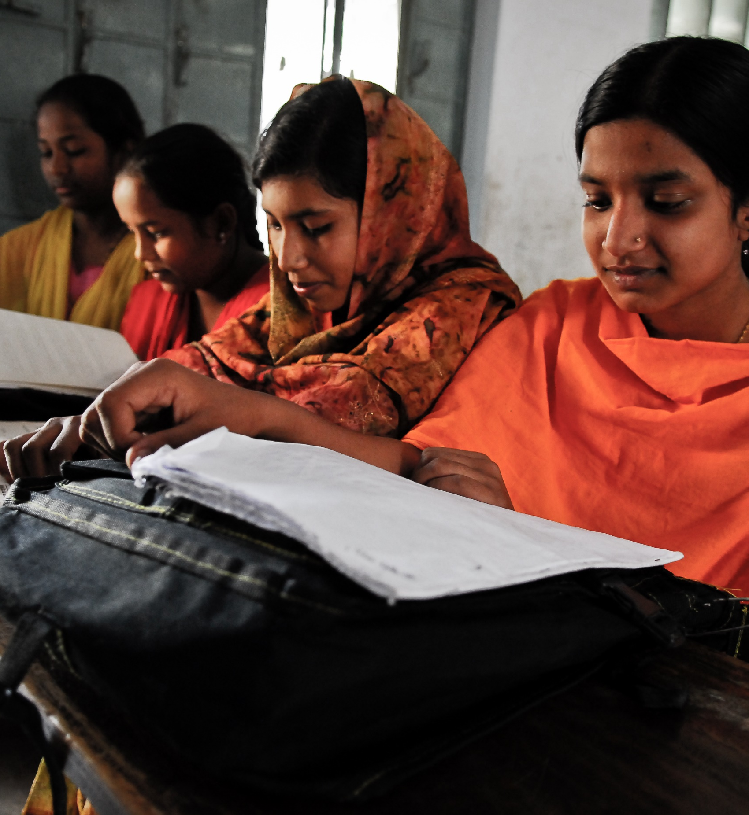
Training and support for teachers on bullying and student-centred and caring classroom management
Teachers should be supported through training, mentoring and accessing resources such as appropriate teaching & learning materials to foster a student-centred and caring school environment.
There should be pre- and in-service training to increase teachers’ familiarity with bullying prevention and interventionand to learn about how to achieve student-centred and caring classroom management and school environment.
Asian Development Bank Secondary Education Sector Development Program

Slide 11
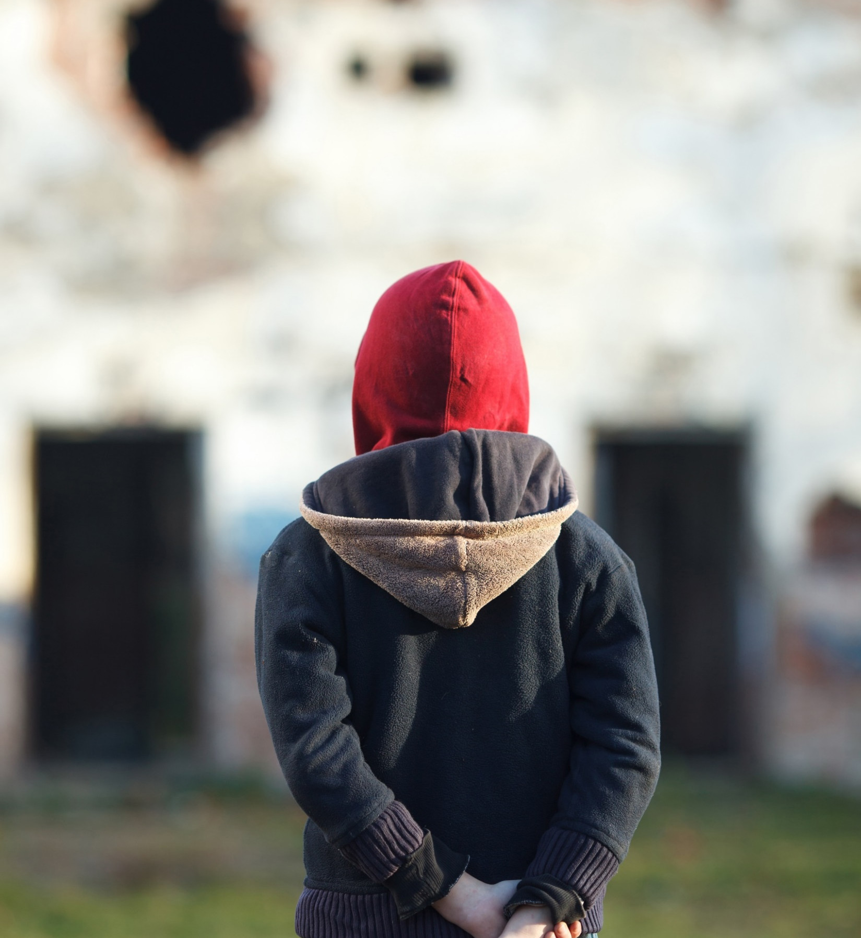
Reporting mechanisms for students affected by bullying, together with support and referral services
Schools should have staff responsible for monitoring bullying. Reporting channels and mechanisms need to be consistent and known by the whole school community, appropriate to different ages, and confidential.
The school system should be integrated with community support and referral services that are known by and accessible to the school community.
Students (in particular but not exclusively targets and bystanders) as well as school staff should feel they can talk about bullying to a trusted person known to them, in the school or outside the school.
Collaboration should be established with social media platforms to ensure that school communities have effective channels to report cyberbullying.
c Getty-bodnarchuk - migrant bullied (1)

Slide 12
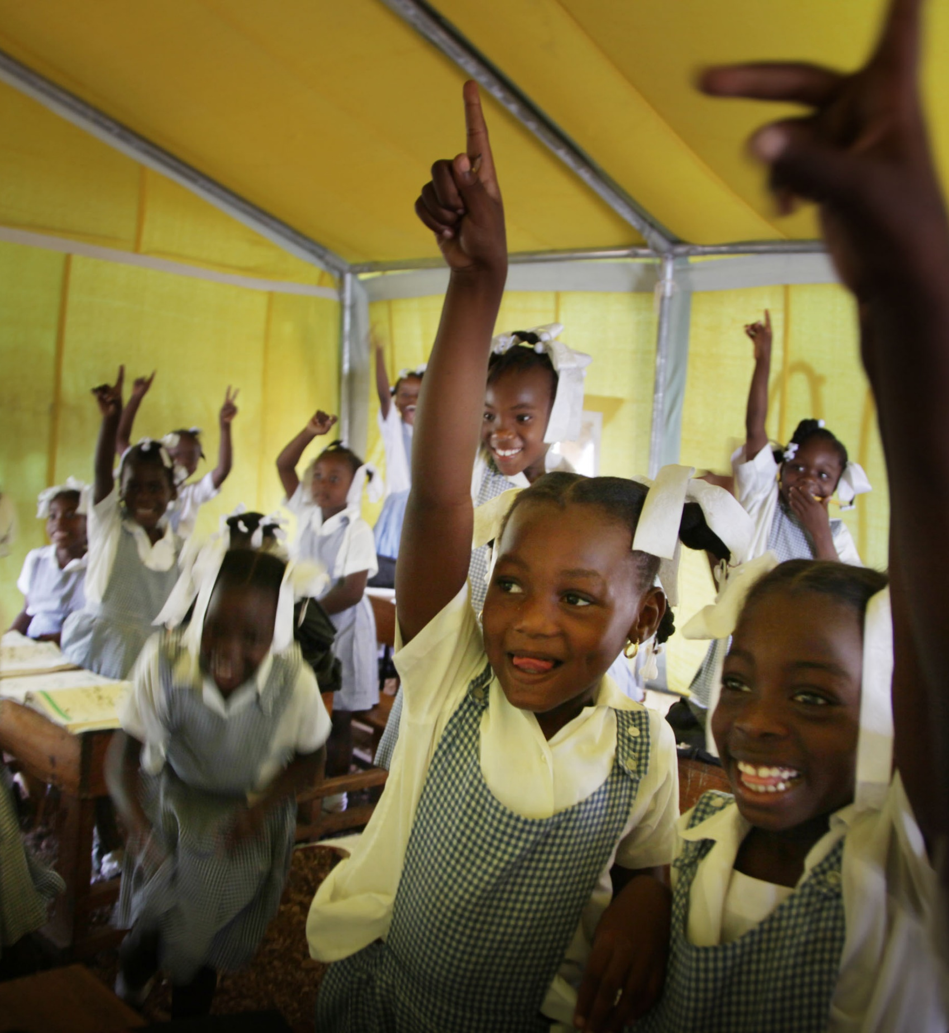
Student empowerment and participation
Bullying is a relational phenomenon that occurs within a network of people; thus, all students should be involved in prevention programs instead of focusing only on perpetrators or targets.
Bystanders play a key role in the dynamics of bullying and should be empowered to support students targeted by bullying.
Attention should be paid to the involvement of students who belong to a minority group in the design and implementation of bullying prevention strategies, to ensure these strategies are inclusive of all students.
Student-led initiatives and peer approaches to prevent bullying should be implemented in conjunction with programmes involving school staff and other adults.
UNICEF-NYHQ2010-0750ROGER LEMOYNE (1)

Slide 13
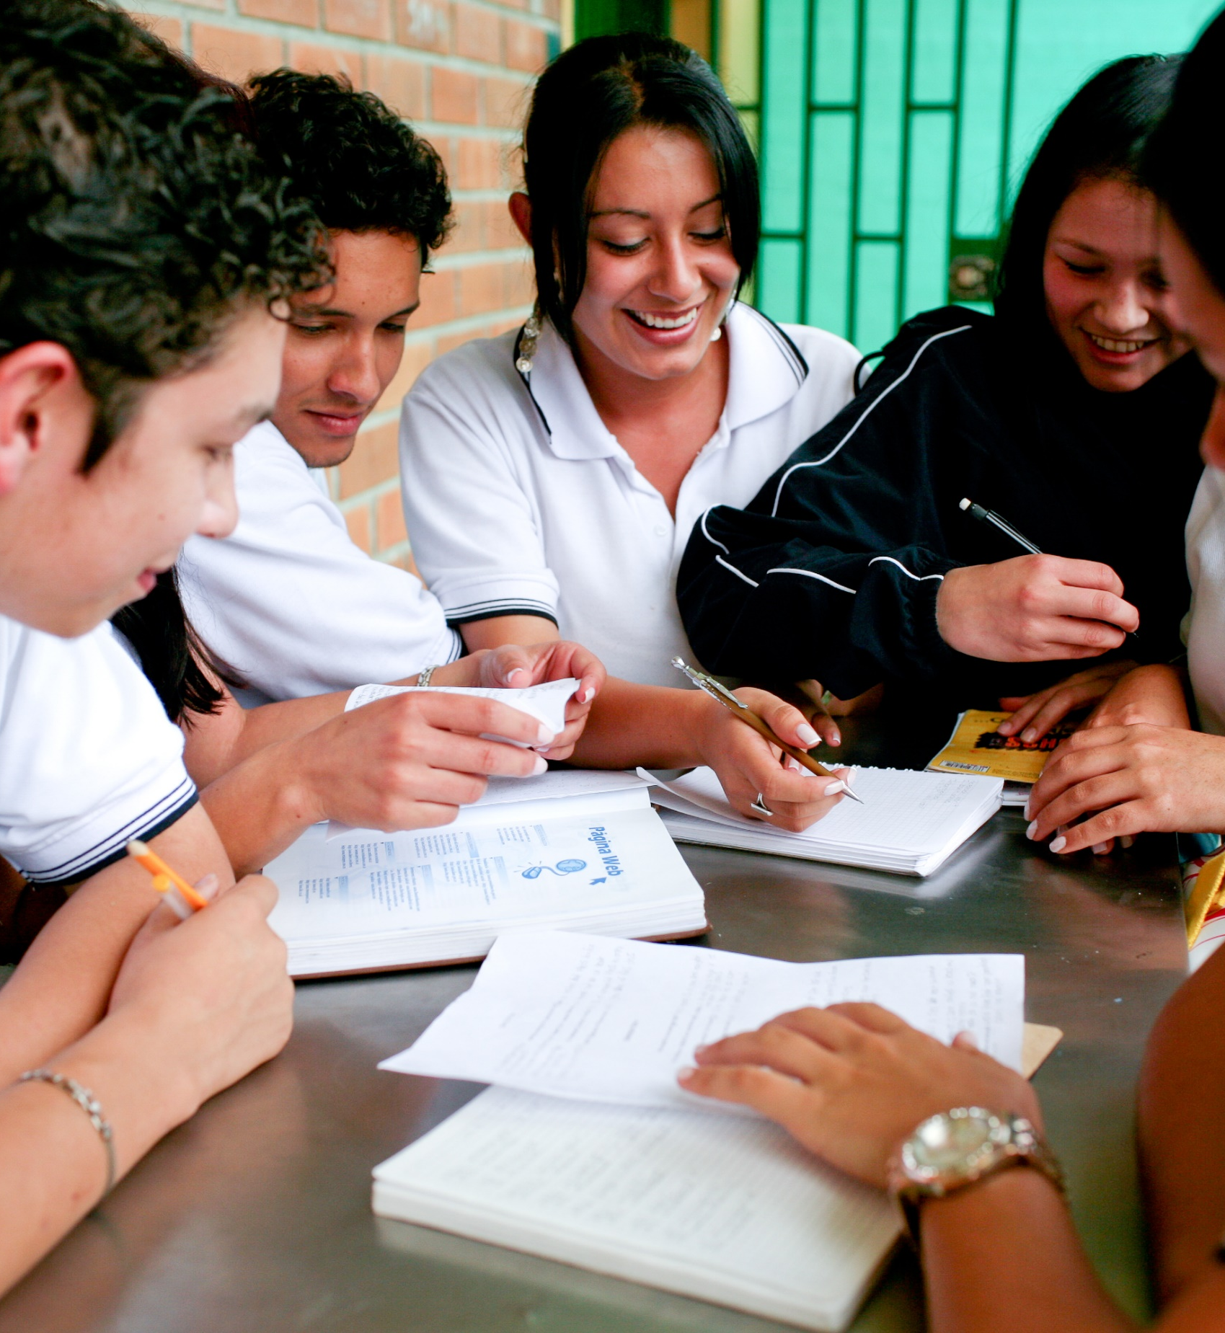
Curriculum, learning & teaching to promote caring (i.e., antibullying) school climate
To reduce bullying, schools need to provide a student-centred and caring school climate.
Curriculum, learning and teaching, plus teacher-student relationships should all be geared towards fostering a student-centred and caring school environment.
To achieve this, student-centred teaching and learning is essential.
World Bank - Columbia (1)

Slide 14

Involvement of all stakeholders in the school community, including parents
All stakeholders in the school community should be involved in anti-bullying initiatives including principals and board, teachers, other school staff, students, and parents, together with other stakeholders in the wider community, such as children and adults who participate in extra-curricular activities, e.g. sports, arts, etc.
Parents, including groups such as Parent Teacher Associations, should be supported to engage on the issue of bullying.
WAD 2016 - Vera Brezhneva (2)

Slide 15

Evidence: monitoring of school bullying and evaluation of responses
It is essential to monitor bullying within schools and across the education system.
Regular assessment of the effectiveness of preventative and intervention measures at a school and system level is essential.
Monitoring and assessment should involve both students and school staff and should include questions about the school climate.
O Driscoll Imaging - Shutterstock.com

Slide 16
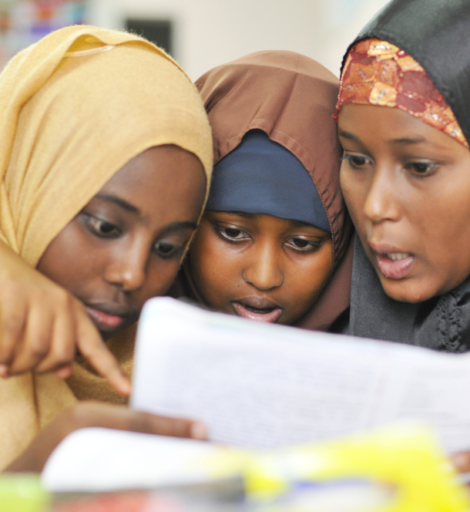
Collaboration and partnerships between the education sector and a wide range of partners (other government sectors, NGOs, academia, digital platforms)
Education authorities should effectively collaborate with different sectors including health, social services, etc.
Other relevant sectors should provide resources and support to reduce bullying and cyberbullying, including social media companies
Collaboration between the educational sector and academia should be fostered to enable research to better understand bullying and how to reduce it.
Udeyismail - Shutterstock

Slide 17

Thank you!
Learn more about the recommendations: https://unesdoc.unesco.org/ark:/48223/pf0000374794?posInSet=1&queryId=2abdbb56-2f9c-4729-8b31-5f173cb59b95
@UNESCO
https://en.unesco.org/themes/school-violence-and-bullying
Ricci Coughlan-DFID - bangladesh underprivileged childrens ed programme SRHR (1)

Slide 18
https://www.fresh-partners.org/fresh-webinarsweb-meetings.html
Agenda for FRESH Coordinating Committee
Review of minutes of last meeting
Round-Table Discussion: Comprehensive Bullying Prevention
Business Arising
  Update on FRESH Webinars
  b) Update on Communications with TCG about Target 4.7
  c) Update on Fact-finding Survey and Collection of Policy/Curriculum Documents
  d) Update on FRESH Working Group on Health Literacy, Life Skills & Social Inclusion
  e) Update from UN Inter-Agency Group on School Health & Nutrition
  f) Updating FRESH Thematic Indicators and Related Materials
New Business
  Working Group on Inclusion/Follow up to the GEM 2020 Report

