Slide 1


Puberty Education &
Menstrual Hygiene Management
Booklet #9 IN UNESCO’s series on
Good Policy and Practice in Health Education

Slide 2


“ Schools are the best platform to reach a wide range of learners before puberty to prepare them for change and keep them in school. This is the importance of the Good Policy and Practice Booklet.”
Irina Bokova,
Director-General of UNESCO

Slide 3
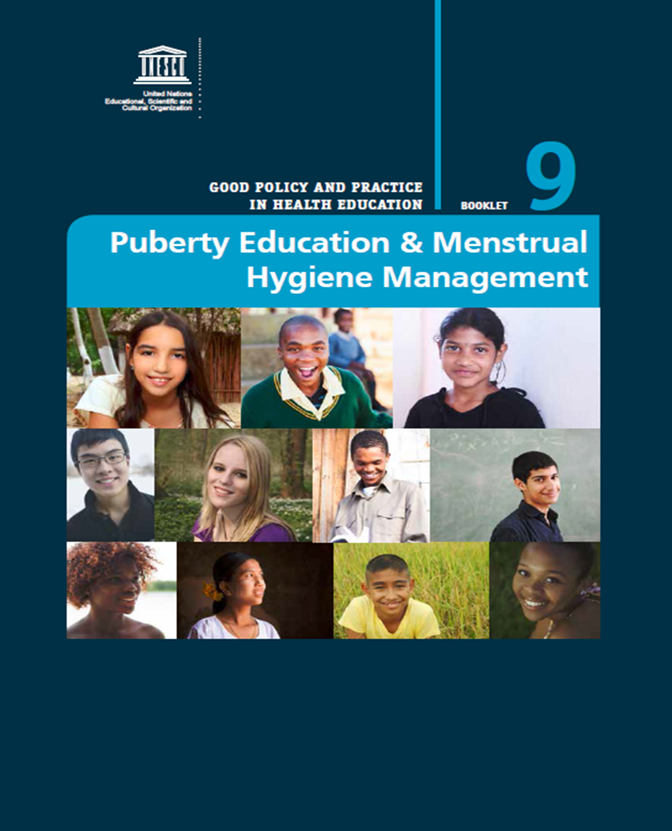
The Policy!
Notes:
Every year a new age group of learners reaches puberty. Yet, despite the urgent and recurring need, there is little systematic and comprehensive guidance on this vital subject for the education sector.
This volume is designed to articulate a rationale for the education sector to improve school health by addressing puberty education and menstrual hygiene management; to describe good policies and practices from different global contexts; and to provide clear action steps for administrators, practitioners and advocates to take on these issues in their education sector.
This document is the product of an extensive literature review, key informant interviews and an international technical consultation.

Slide 4
What is Puberty?
A time of rapid physical, psychological and
cognitive changes - when gender norms and identity are being shaped
        Girls report experiencing stress, shame, embarrassment, confusion and fear due to a lack of knowledge and inability to manage their menstruation
Boys report feeling low self-esteem and feeling
out of control of events in their lives, which can
manifest itself through unhealthy behaviours
© shutterstock
© shutterstock/paulaphoto
Notes:
For more details see p12 of the publication

Slide 5
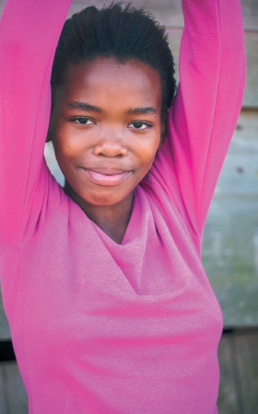
Why does this issue need attention?
By facing puberty without preparation learners are left confused and unsupported, which in turn affects the quality of their education.
In some cases it may directly affect school attendance.
© shutterstock/Nolte Lourens
Notes:
See section 2, p12 of the publication for more details.
Many learners enter puberty unprepared. Some (small-scale) studies in South Asia have shown that 66% of girls know nothing about menstruation until menarche, the first occurrence of menstruation.(1).
By facing puberty without preparation learners are left confused and unsupported, which in turn affects the quality of their education. In some cases it may directly affect school attendance. 39% of girls in a small-scale study in Ethiopia reported reduced performance at school (2) and 95% of of girls in a small-scale study in Ghana reported sometimes missing school due to menstruation (3).
Without any education on puberty or sexuality, learners are also vulnerable to infection and unintended pregnancy. The information they receive is often selective and surrounded by taboos and mis-information. Often the education sector avoids the issue by considering it a private matter or a problem to be addressed within the family. This document uses puberty education as an entry point to effect change.
__________________________________________
1. Mooijman, A., et al. 2010. Strengthening Water, Sanitation and Hygiene in Schools A WASH guidance manual with a focus on South Asia. The Netherlands, IRC.
2. Scott L., et al. (2009, draft) Impact of providing sanitary pads to poor girls in Africa. University of Oxford. In House, S., et al. 2012. Menstrual hygiene matters. A resource for improving menstrual hygiene around the world. London, WaterAid.
3. Abera Y (2004) Menarche, menstruation related problems and practices among adolescent high school girls in Addis Ababa. MSc thesis. In House, S., et al. 2012. Menstrual hygiene matters. A resource for improving menstrual hygiene around the world. London, WaterAid.

Slide 6
Why Should Education Ministries
Get Involved?
The education sector is responsible for contributing to the healthy development of its learners;
It must help them respond to and manage the changes and challenges they face in life; and
Puberty education and improved menstrual hygiene management can positively impact on attendance and the quality of education
Notes:
Primary schools are the ideal location to reach a large proportion of learners before puberty:
- There are 593 million learners in primary school (globally) who can be reached through school-based programmes,
- In low income countries only 54% transition to secondary school
- There are 29 million primary school teachers globally who could be trained to provide effective puberty education
Impact on attendance:
In a study in Ghana 120 girls between the ages of 12 and 18 were enrolled in a non-randomized trial of sanitary pad provision with education. Girls either received puberty education alone, puberty education and sanitary pads, or nothing (the control group). After three months, providing pads with education significantly improved attendance among participants, and after five months, puberty education alone improved attendance to a similar level. The total improvement through pads with education intervention after five months was a 9% increase in attendance. While this study is small-scale, it indicates that puberty education even if unaccompanied by menstrual hygiene materials and infrastructure improvements can have an impact on education. A larger-scale cluster randomized trial to confirm the findings of this study has begun, although its data is not currently available.
From: Montgomery P., Ryus C.R., Dolan C.S., Dopson S., Scott L.M. 2012. Sanitary Pad Interventions for Girls’ Education in Ghana: A Pilot Study, PLoS One, Vol. 7(10), pp. 1-10.
For more details see p13 of the publication

Slide 7
Conceptual Framework
The FRESH Framework identifies
4 KEY PILLARS
as the basis for school health responses:
EQUITABLE
SCHOOL HEALTH
POLICIES
SCHOOL-BASED
HEALTH AND
NUTRITION
SERVICES
SKILLS-BASED
HEALTH
EDUCATION
SAFE LEARNING
ENVIRONMENT
Notes:
The education sector’s effective engagement with the subject of puberty transcends the classroom; it concerns multiple aspects of the educational setting and notably menstrual hygiene management. This book therefore presents a rationale for puberty education and menstrual hygiene management set within a comprehensive school health approach.
FRESH is a comprehensive, overarching framework for promoting health through schools. It can be used with or instead of other well-known school health frameworks, such as Health-Promoting Schools, Child-Friendly Schools, or school health and nutrition programmes to promote the health and well-being of students, their families and school staff. The FRESH Framework identifies four key pillars as the basis for school health responses: equitable school health policies, skills-based health education, safe learning environment, and school-based health and nutrition services. It is through these four mutually reinforcing components that an effective school health response can be implemented.
For more details see p18 of the publication

Slide 8
What is needed?
Learners need knowledge, attitude and skills to live healthy
The entire school community needs safe and health promoting environments
  Physical setting
  Social setting
The entire school community needs access to commodities and health services
© shutterstock/szefei
Notes:
Within the context of the FRESH framework, three main requirements stand out

Slide 9
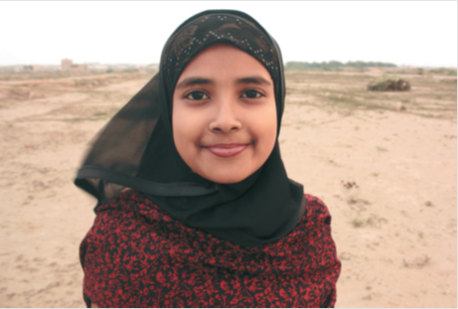
What is UNESCO’s Role?
Individual Learning
Social
Learning
© shutterstock/Aman Ahmed Khan
Notes:
The efforts necessary to improve infrastructure to meet the physical needs of learners and staff have been covered in detail by UN agencies, for example in the empirical work by WHO and UNICEF’s WASH in Schools initiative, and by non-governmental organizations (NGOs) and other civil society organizations such as WaterAid.
Similarly, commodities are being addressed by social entrepreneurs, such as SHE Rwanda, and corporations, such as P&G.
While more work needs to be done in each of these quarters, UNESCO’s book does not go over ground covered by those partners, but rather builds on it by covering the areas inadequately addressed by the education sector and in which UNESCO has a comparative advantage.
These are the spheres of individual and social learning (and what is required to provide these).
For more details see section 3, starting p20 of the publication.

Slide 10
Teaching and Learning (Individual)
Puberty should not be taught in isolation.
It should be delivered through an age- appropriate and skills-based curriculum.
It should start as early as age five and continue into young adulthood.
Notes:
Puberty should not be taught in isolation, rather it should be delivered through an age and developmentally appropriate skills-based health education curriculum that starts as early as age five and continues into young adulthood.
It should be skills-based, scientifically accurate, gender-sensitive, contextually adapted, rights-based, age-appropriate, inclusive and comprehensive. It is part of a larger skills-based health curriculum, which is an integral part of a comprehensive school health approach.
NOTE TO PRESENTERS:
International standards (see UNESCO and WHO/BZgA below) highlight the importance of starting early, around the age of 5 when primary education starts, and starting with simple concepts and building-up progressively (see UNESCO’s ITGSE Vol II p23 for example on puberty).
It might be pointed out that in a number of life-skills curriculum puberty is already addressed. This is true in a number of countries, however a review (UNESCO and UNFPA. 2012. Sexuality education: A ten-country review of school curricula in East and Southern Africa. Paris, UNESCO.) showed that:
Most curricula addressed the experience of puberty strictly as a biological process without acknowledging the changed social environment (for example increased harassment, parental monitoring) that can also generate considerable confusion and difficult feelings for pubescent girls.
While content is often age-appropriate, the most common exception is the delayed delivery of information about puberty.
In addition, other reviews including in Asia and LAC have shown that teachers can be selective on what they teach, and avoid topics they feel uncomfortable with, including puberty and menstruation.
Puberty education should be provided in the context of a comprehensive sexuality education which is integrated into a broader skills-based health education curriculum. Puberty education covers a number of topics that are also covered by comprehensive sexuality education (e.g. reproductive systems, gender, privacy and bodily integrity etc.). The main difference is that puberty education includes some topics that are not covered in CSE such as hygiene, and will go into detail on issues concerning the physical environment of the school.
For more details see p20 of the publication
and
International Technical Guidance on Sexuality Education (ITGSE) An evidence-informed approach for schools, teachers and health educators. Volume II Topics and learning objectives. UNESCO 2009.
and
WHO and BZgA. 2010. Standards for sexuality education in Europe. A framework for policy makers, educational and health authorities and specialists.

Slide 11
Teaching and Learning (Social)
The aim is to develop lifelong, health-seeking behaviours, skills to understand and support others and mitigate gender-based violence, teasing, bullying and other anti-social behaviours.
In short, to transform the environment.
Notes:
The book offers alternatives to a dominant narrative that presents puberty as shameful for girls while in contrast celebrating male virility.
To be a safe and secure environment, the school needs policies that protect individuals from harassment and bodily harm. But creating such an environment takes more than simply policy; it is a product of attitudes and skills related to empathy and respect.
The aim is to develop lifelong health-seeking behaviours, while at the same time promoting skills for understanding and supporting others, and mitigating gender-based violence, teasing, bullying and other anti-social behaviours.
In short, our aim is transformation to an equitable, supportive and healthy school environment.
For more details see section 3, p25 of the publication for example on wider school health context and importance of including boys and men, and involving parents and the community.

Slide 12

What is in the Book?
Context and Rationale
  What is puberty
  Why ministries of education should get involved
Planning for Action
  The characteristics of good quality puberty education
  Good practices in menstrual hygiene management
  Key issues for programme development
Implementation and Sustainability
  Teacher training
  Partnerships
  Monitoring and Evaluation
© shutterstock/Nolte Lourens
Notes:
Introduction
2. CONTEXT AND RATIONALE
2.1 What is puberty?
2.2 Why ministries of education should get involved
2.3 Focusing Resources on Effective School Health
3. PLANNING FOR ACTION
3.1 The characteristics of good quality puberty education
3.2 Good practices in menstrual hygiene management
3.3 Key issues for programme development
4. IMPLEMENTATION AND SUSTAINABILITY
4.1 Curriculum development
4.2 Teacher training
4.3 Increasing coverage through partnerships
4.4 Quality assurance through monitoring & evaluation (M&E)
Conclusion

Slide 13
What can the Education Sector do?

Slide 14
What are the Main Messages?
1. Educate all learners about puberty
Provide them with a skills-based health education that develops their knowledge, attitudes, skills, and behaviours for their health now and throughout their lifespan.
Topics should be imbedded in a larger health curriculum that promotes healthy relationships and gender equity.
It should be age and developmentally appropriate, properly prepare girls and boys for life changes and mutual understanding and respect, and thus should start as early as five years old and continue through to young adulthood.
Notes:
1. Educate all learners about puberty: Provide them with a skills-based health education that develops their knowledge, attitudes, skills, and behaviours for their health now and throughout their lifespan. The topics should include hygiene, sanitation and sexual and reproductive health, including puberty. These topics should be imbedded in a larger health curriculum that promotes healthier lives, relationships and gender equity. It should be age and developmentally appropriate, should properly prepare leaners for life changes before they experience them and thus should start as early as five years old and continue through to young adulthood.
Puberty education should cover a number of different topics including:
.What is puberty?
.When does puberty start? When does it end?
.What changes take place in female and male bodies? Body image.
.Hormonal and psychological changes and how to manage them.
.The male and female reproductive systems, i.e. sexual and reproductive anatomy and physiology, the maturation process.
.What emotional changes are experienced?
.Ejaculation, erections, wet dreams, male hygiene.
.What is menstruation? What is premenstrual syndrome (PMS)? Does menstruation hurt? How do you manage pain? How do you manage your menstruation? Menstrual hygiene materials, hygiene around menstruation and how to dispose of menstrual materials. Menstrual calendar for tracking monthly menstrual flow, as well as identification of signs that a girl is going to have her period (e.g. breast sensitivity or changes in vaginal discharge).
.Cultural and religious beliefs, social norms and myths surrounding menstruation and puberty (location-specific).
.Gender roles.
.Privacy and bodily integrity.
.Adult perceptions - changing expectations and roles, the way girls and boys are viewed as a result of reaching puberty (context-specific).
.How puberty affects a young person’s role and relationship with family and friends.
The complete package will be dependent on the country context. Some topics will only be applicable in certain countries but should nonetheless be included, such as female genital cutting (FGC).
For more details see p20 of the publication
and
International Technical Guidance on Sexuality Education An evidence-informed approach for schools, teachers and health educators. Volume II Topics and learning objectives. UNESCO 2009.
and
WHO and BZgA. 2010. Standards for sexuality education in Europe. A framework for policy makers, educational and health authorities and specialists.

Slide 15
What are the Main Messages?
2. Provide safe environments,
physical and social
Equip all schools with safe water and hand-washing facilities, adequate sanitation facilities, and clean and safe latrines.
Skills-based health education and policies should be in place to create a safe social environment.
Thus, healthy individual behaviours can collectively contribute to a health promoting social environment which values respect, tolerance and non-violence.
Notes:
For more details see p35 & p39 of the publication

Slide 16
What are the Main Messages?
3. Connect learners to health services and commodities
Provide school-based health, counselling, and nutrition services, where possible.
Provide an effective referral system, to health service providers, child protection services and community support groups.
Create strong cross-sectoral linkages with the ministry of health, and other health providers.
Notes:
Provide school-based health, counselling, and nutrition services, where possible. An effective referral system, to health service providers, child protection services and community support groups, is also helpful to fill the needs of learners beyond what the school can provide. Thus strong cross-sectoral linkages with the ministry of health should be created.
For more details see p19, and for example section 4, p41 for partnerships.

Slide 17
Notes:
Increased knowledge
Increased self confidence and emotional coping skills
Better decision making skills
Improved social skills
Positive gender attitudes

Slide 18
Way Forward
Stronger emphasis on puberty education and menstrual hygiene management in comprehensive sexuality education and skills-based health education.
Improved pre- and in-service training of teachers on puberty education and menstrual hygiene management.

Slide 19

Thank You.
unesco.org/new/health-education

